Slide 1
Identification of Disinformation types in LLMs
23 August 2024
Bhavana Ramesh
Durwankur Gursale
Abram Jopaul

Slide 2
Problem Statement
RQ1: Predictions of SLMs v/s LLMs. Can SLMs outperform LLMs with appropriate dataset ?
RQ2: How efficiently different LLMs label the category of disinformation over simple run and when structured prompts are used?
RQ3: Which is the most deceptive disinformation category and reasons for the same?

Slide 3
Recap
SLM vs LLM - RoBERTa showing progress in accuracy as we fine-tuned it on more data
Performed these prompting techniques in Llama-3-8B-Instruct :-
Zero shot prompting
Chain of thoughts prompting
Few shots prompting
Zero shot, CoT - Prone to positional bias
Few shots - 6% increase in the accuracy and less prone to positional bias.

Slide 4
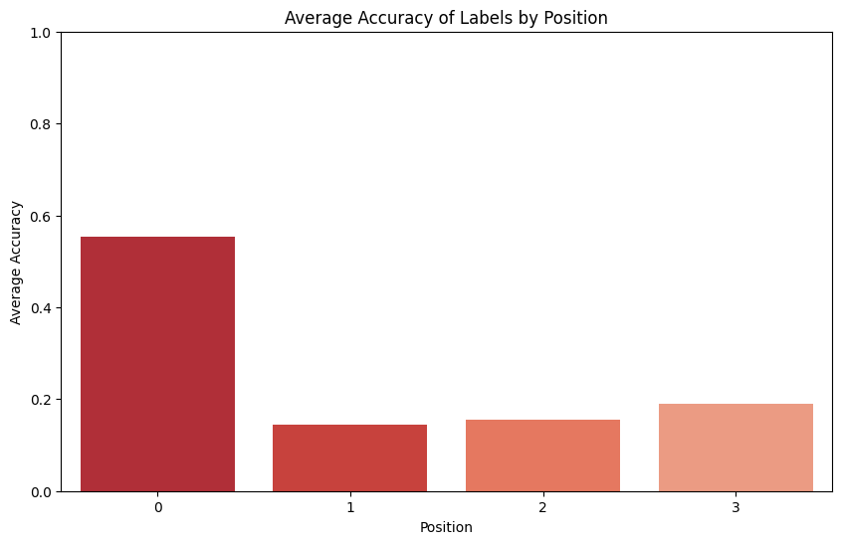
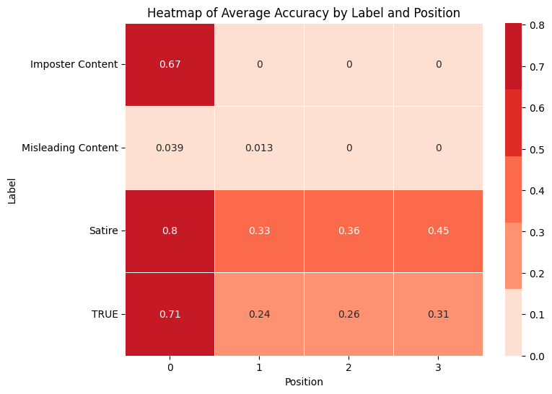
Positional Bias - Llama
We have 4 labels and 4 positions, P(4, 4) = 4! = 4×3×2×1 = 24
Evaluating all the 24 permutations of 4 labels - Llama-3-8B-Instruct-24-permutations

Slide 5
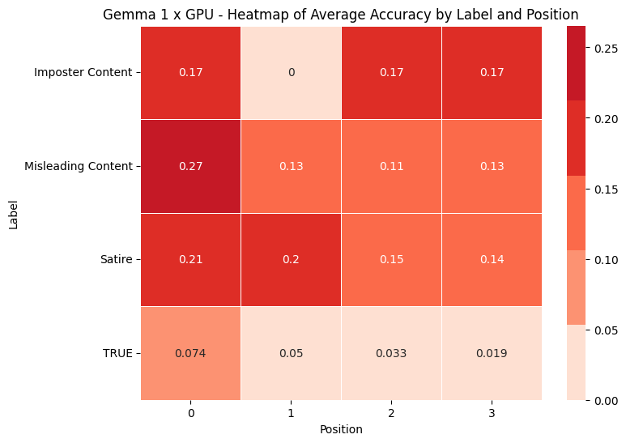
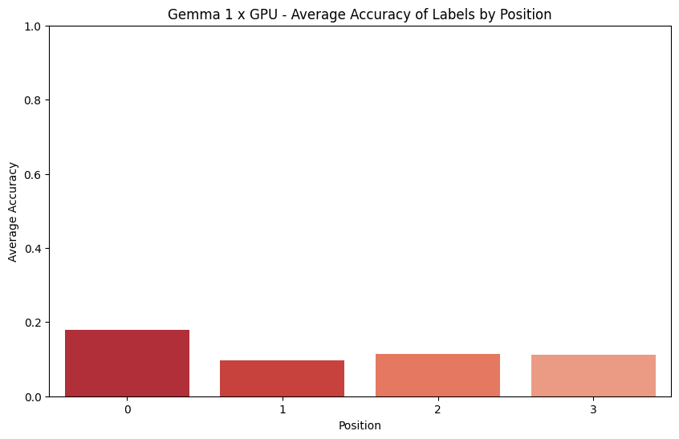
Positional Bias - Gemma in Single GPU
Less accuracy compared to Llama ( Gemma 9B vs Llama 8B)
Not having sufficient GPU power
Gemma-2-9b-it-24-permutations

Slide 6
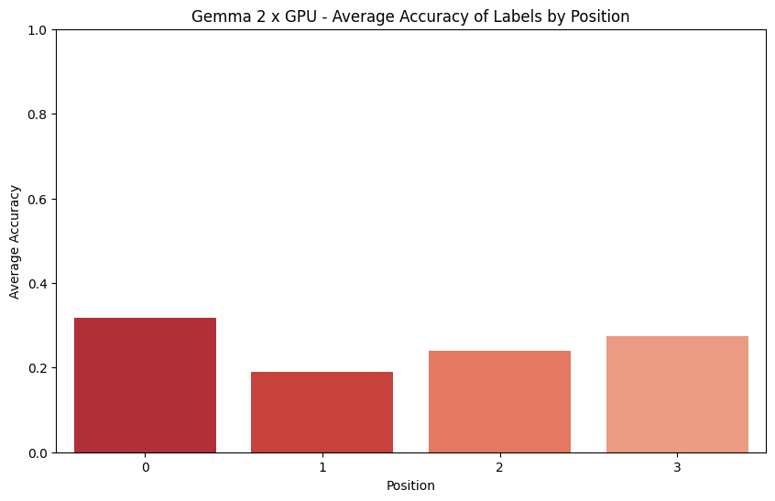
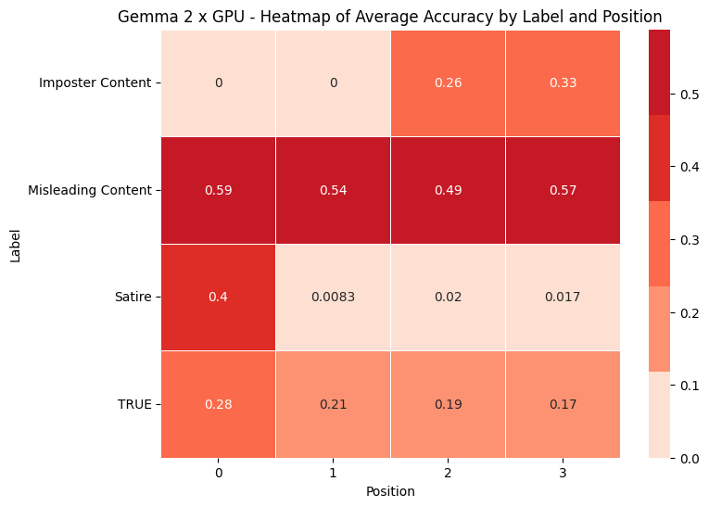
Positional Bias - Gemma in 2 GPUs
Increase in Accuracy as GPU power increases.

Slide 7
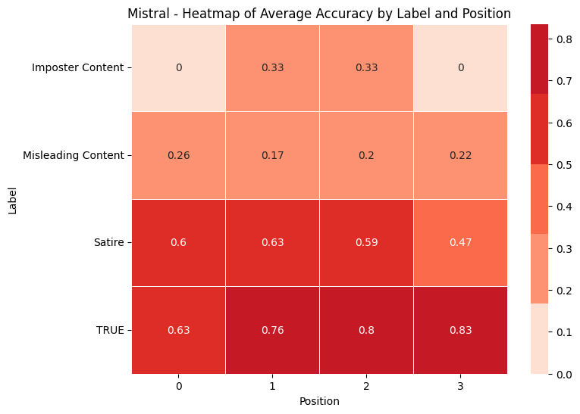
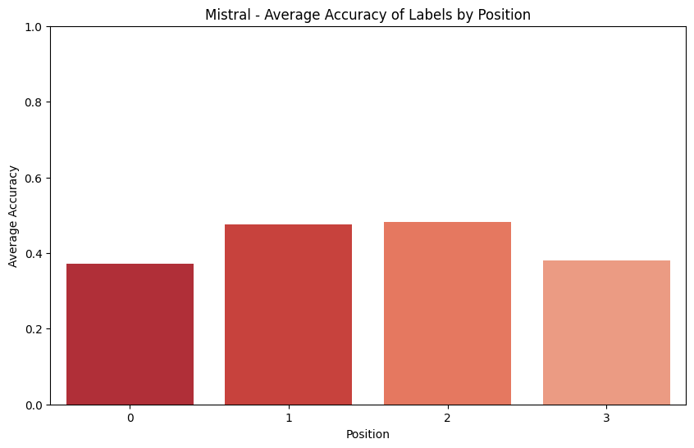
Positional Bias - Mistral
Less positional biased compared to Llama and Gemma
Less time and more GPU efficient

Slide 8
Positional Bias in LLMs: Supporting Research
Research has shown that LLMs, like causal transformers, inherently store positional information within their hidden states, affecting the model's attention weights and causing position bias - [Yu, Yijiong]
U-Shaped Attention Bias - [Hsieh, Cheng-Yu] - Study highlighted a U-shaped attention pattern where LLMs assign higher attention weights to tokens at the beginning and end of a sequence, which can lead to a bias towards the first document or label regardless of its relevance.

Slide 9
Future Works
Check for Few Shots prompting in Gemma , Mistral
Binary classification analysis

Slide 10
Thank you

